Slide 1

Adobe Analytics Challenge 2021
adobeanalyticschallenge.com
TEAM NAME
MEANCODE
TEAM MEMBERS
Swatilekha Roy, swatilekha.roy4@gmail.com
Debasmita Bhakat, dbhakat1999@gmail.com
Surabhi Roy Chowdhury, surabhi.8991@gmail.com
FACULTY MENTOR :-
SUKHENDU MONDAL, sukhen.cse@cgec.org.in

Slide 2
AGENDA
What key differences exist between a purchase flow on mobile vs. desktop, and how should we treat those platforms differently/the same?
1
When a cart is abandoned, and a Guest comes back and purchases it; how do they come back, and from what Marketing Channels are most successful? How do we help drive recovering these carts?
2
Provide analysis of purchasers, grouping them based their behaviors prior to purchase.
3

Slide 3
Key Differences Between Purchase Flow on Mobile vs. Desktop
1. Guests activity on the site
(0-2 hours) -> I) Viewing product -> 16.1%
II) Wishlist/ add to bag products -> 16.133%
III) Cart Removal -> 16.08%
IV) Cart addition -> 16.4%
V) Order -> 16.53%
VI) Checkouts -> 16.31
(5-15 hours) -> I)view products-> 0.55%
II)other activities(wishlist/ add to bag products, Cart Removal, Cart addition,Order, checkouts) -> 0.03%
Conclusion: Guests staying on the site for shorter periods(from mobile devices)tend to be much more active compared to the ones who stay for longer periods(from websites).
Analysis Link
2. Most guests visit during
7:00am- 7:00pm-> guests= avg 4,25,000 (approx) -> guests from mobile devices(72% approx)
Peak time-> 6:00pm-> guests -> 5,019,083-> guests from mobile devices- 77.8%
Conclusion: Late office/ After office hours are the most rush hours.
Analysis Link

Slide 4
3. Guests staying on the site
(0-2 hours) -> use mobile device.(75.15%)
(5-15 hours) ->stay from non-mobile devices(96.45%) ->websites(95%)
Conclusion: Guests staying on the site for shorter periods, stay from mobile, and guests staying for longer periods stay from websites.
Analysis Link
4. Popular Payment Method
I) CC (69.2%) -> Mobile(63.8%) || Non-Mobile(36.2%)
II) PAY_PAL (18.4%) -> Mobile(74.2%) || Non-Mobile(25.8%)
III)GC (4.7%) -> Mobile(55.7%) || Non-Mobile(44.3%)
IV)CREDIT_CARD_NUMBER(3.3%) -> Mobile(60.2%) || Non-Mobile(39.8%)
V) DRC(2.1%) ->Mobile(58.6%) || Non-Mobile(41.4%)
VI)EMVCO_SRC(1.9%) ->Mobile(68.3%) || Non-Mobile(31.7%)
Conclusion: During rush hours, people have mobile devices handy, so those are used to access the sites. Late office/ After office hours are the most rush hours.
Analysis Link

Slide 5

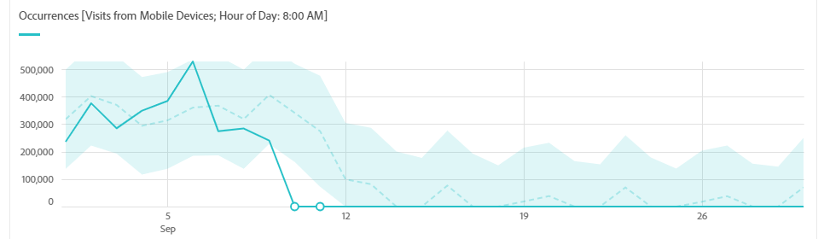
5. Most visitors from countries
I) United States (87.9%)
-First time visitors -> 48.24% -> Mobile device -> 79.7% ||Non-mobile devices->20.3%
-Average time on the site- 1:08 minutes
-Purchasers (Mobile devices)- 48.85% || Non-Purchasers(Mobile devices)- 51.15%
-Time spent per visit->Mobile devices->40.8% || Non-Mobile devices->59.2%
II) Canada (2.8%) -> First time visitors -> 53.21%
III) Mexico (1.3%) -> First time visitors -> 47.44%
Conclusion: USA holds the majority of customers and a detailed analysis on USA shows, purchasers who spent more time on the site, use non-mobile devices, desktop mostly
Analysis Link

Slide 6
How should we treat those platforms differently/the same?
As most people pay through CC and they do it from mobile, so auto-filling CC details will be handy, also saving the payment details once they are filled. Include client-based payment storage options.
As mobile wireless connections are slower than desktop and most visits are from mobile devices, so the development of the app / accessing website from mobile should be given more priority.
Time spent per visit from mobile devices is comparatively very less than desktops. So, to increase that give accurate product recommendations. Also, giving extra rewards in the form of digital coins can increase the average time spent on the site.
People who spend more time on the site which is basically from desktops end up doing no precise activity. Adding reward coins for time spent will increase the probability of them buying something (using some cash+ reward coins in their account).

Slide 7
Cart Abandonment and Return Frequency
Analysis Link
Through Analysis: When the cart is abandoned how likely a customer return.to visit the cart
Less than 1 day ⇒ page view to checkouts ⇒ 104.3% to 57.6%
1 to 3 days ⇒ page view to checkouts⇒ 98.8%to 14.4%
But what making these customer to return back?
How do they come back, and from what Marketing Channels are most successful?
Abandoned cart Analysis Link
⇒ Return visit
⇒ Cookie Support
Conclusion:Cookies support one of the primary key of any e commerce website
Enabled⇒ 100%
Disabled⇒ 0.00%
Conclusion:Now we have to look into the ENABLED cookie support and find out through which Customer are visiting the site

Slide 8
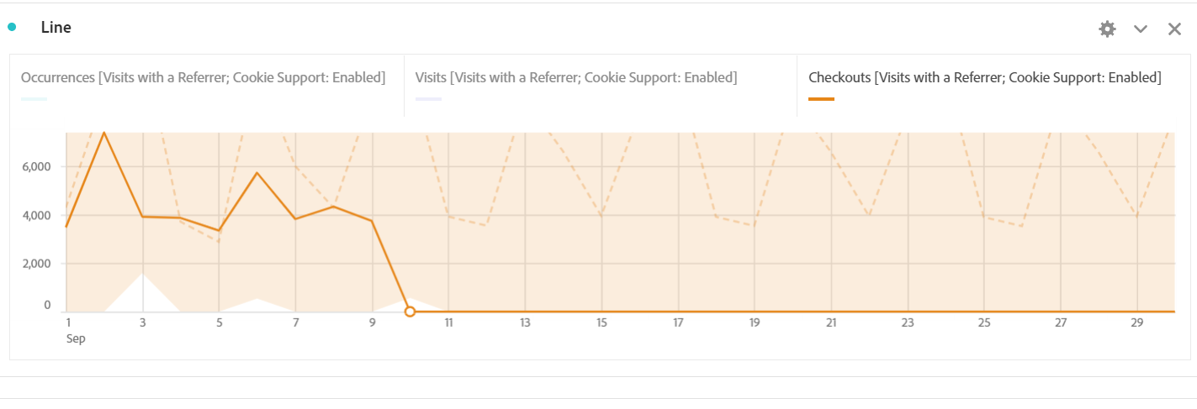
Enabled:
Visits with a Referrer ⇒ Occurance to Checkout : 46.2% to 45.5%
Conclusion:Segregating it into Marketing Channel to get clear view, what channel is helping us to bring back our customers i.e
⇒ Paid Search(Checkouts) ⇒ 22.9%
Conclusion: Included Paid search as it brings the highest return of customer
Visits from Campaign ⇒ Occurance to Checkout : 38.5 % to 37.4%
⇒ Paid Search(Checkouts) ⇒ 30.4%
Conclusion: Social Media is contributing least to the customer return.i.e Occurance to Checkout :1.4% to 3.0%

Slide 9
With the Marketing Channel which devices are likely to access the Site.Hence segregating Marketing Channels based on Devices accessed
Marketing Channel
⇒ Paid Search ⇒ Occurrence ⇒ 22.7%
⇒ Mobile Devices (Occurrence to Checkout): 70.6% to 76.1%
⇒ Mobile Phones ⇒ 98.0%(Highest)
⇒ Non Mobile Devices (Occurrence to Checkout) 29.4% to 23.9%
⇒ Email ⇒ Occurrence ⇒ 20.5%
⇒ Natural Search ⇒ Occurrence ⇒ 19.5%
Conclusion: Hence, Mobile phone users are more likely to visit the site again and checkout the product than other devices.

Slide 10
What population uses Mobile phone in Mobile type devices the most are our Primary Customers or Key Purchasers?
⇒ Mobile Type Devices
⇒ Mobile Phones
Further segregated based on the Age Group:
⇒ Adults ⇒ Page view to Checkout :81.1% to0.00%
⇒ Purchaser ⇒ Page view to Checkout ⇒ 75.9% to 0.00%
⇒ Kids ⇒ Page view to Checkout : 80.4% to 0.00% :
⇒ Purchaser ⇒ Page view to Checkout: 74.4% to 0.00%
⇒ Unspecified ⇒ Page view to Checkout: 59.0% to 100%
Conclusion: Here the unspecified age grouped customer’s page view to Checkout ratio is the highest!

Slide 11
Provide analysis of purchasers, grouping them based their behaviors prior to purchase.
Page Metrics according to registration status of users
61.9% users are logged in, including 39.6% Purchasers and 60.4% Non-Purchasers who access Disney app mostly through mobile devices.
Anonymous users are mostly non-purchasers.
Conclusion: Conversion rate for Logged-in users is only 3.45%, which can be enhanced with more loyalty rewards.
Analysis Link
Searching w.r.t age
Adults spend 22.9% more average time on Disney App than kids.
The maximum no. of page views/visits is by unspecified users (76.2%) followed by 47.7% adults (47.7%) and 46.8% kids.
Kids spend more avg. time on app through “Redirects” and show more page views/visits through “Autosuggests”.
Adults spend more avg. time on app through “Deep Links” and show more page views/visits through “Autosuggests”.

Slide 12
Provide analysis of purchasers, grouping them based their bProvide analysis of purchasers, grouping them based their behaviors prior to purchase.
ehaviors prior to purchase.
Conclusion: Increase ‘Redirects’ to increase traffic, mainly kid-frequented sites like YouTube Kids, Nat Geo, Tictoc, etc. and invest in ‘Autosuggests’ to lure all age groups.
Analysis Link
3) Seasonal Breakdown of Customer Loyalty
More new customers explore app (page views, search redirects) during Fall and Holidays than return customers and loyal customers.
97.4% of page views and 91.5% checkouts are in unaccounted times of the year when users register on the platform and interact with cart. Most of them are not customers.
Loyal customers move through the checkout process more successfully than new ones.
Conclusion:
There may be better effort to track the unspecified seasons when customer interaction is maximum to customise season-wise products and drive traffic.
There may be pop-ups or prompts to provoke non-customers to engage and sign up.
. Analysis Link 1 Analysis Link 2

Slide 13
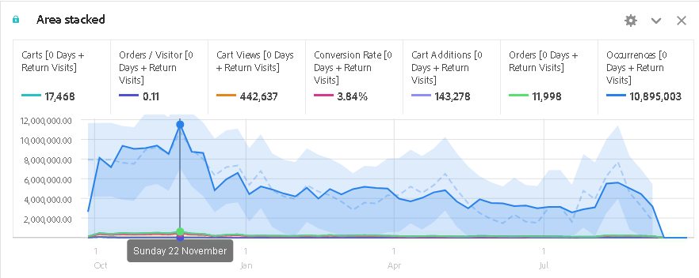
Provide analysis of purchasers, grouping them based their bProvide analysis of purchasers, grouping them based their behaviors prior to purchase.
ehaviors prior to purchase.
4) First Time Visits vs. Return Visits
Conversion rate for first time users is 2.7% as compared to 2.54% in return users.
Very few return visits after 50 days.
Both first time visitors and return visitors tend to not do cart removals.
User returning after 7 days have 54% orders as compared to 29.8% users returning within a day.
Analysis Link Graph Link

Slide 14
Provide analysis of purchasers, grouping them based their bProvide analysis of purchasers, grouping them based their behaviors prior to purchase.
ehaviors prior to purchase.
Conclusion:
From the above graph which has a detailed metrics analysis from Oct 1, 2020 to Sep 30, 2021, it’s clear that maximum orders / visitor, Cart Views, Conversion Rate and other interactivity is during the months of September, October and November.
There is a clear peak on 22nd November with 10,895,003 occurrences for return visits.
5) Fallouts for Customers
Out of all visitors, 98.5% are from Co-op regions inclusive of 55.1% ITP Visitors.
For return visits, about 11.7% users have existing carts while 5.8% of them abandon carts.
Very few customers are Chrome users.
About 3% first time or return visits are single page visits.
Conclusion:
For both first time and return visits, maximum users are ITP Visitors, so there must be additional prompts to request them for allowing us access to their data.
Analysis Link

Slide 15
Provide analysis of purchasers, grouping them based their bProvide analysis of purchasers, grouping them based their behaviors prior to purchase.
ehaviors prior to purchase.
6) Journeys For Customers
Page “Featured” section attracts maximum, i.e., 83.7% visitors (83.7%), out of whom, 23.2% go to shop.
11.8% users use search engine to yield results, 28.8% use miscellaneous means while only 4.2% are attracted through sales posters.
About 90% Users usually enter Disney app most through Home Page, Product Listing Page, Contentand Landing Page.
54.4% visitors go to content shop.
92% go to featured zone.
Conclusion:
Sales sections should be paid more heed to, with highlight to season-specific sales to attract more customers.
Since featured section lures most users, it could have links to most relevant and popular products or redirects.
More attention may be paid to the search engine results with focus on customizing results for each customer.

Slide 16
CONCLUSION
Through the whole analysis we can conclude that Key Customer who has highest Page View to Checkout Ratio are Unspecified. By gathering more data and emphasizing it on their behaviors we could compare and conclude what makes them the key customer and how we can implement it on others.
On the other hand if we increase the View from Social Media by implementing a good Social Media Marketing Strategy as in current time it has its highest reach to Young, Adults and on Kids. There is a high possibility to increase the flow of site visit and hence purchase.
Adding digital coins to users’ account which they can later use for purchase on the basis of time spent on the site will help in increasing average time spent per user and more purchase, ultimately as along with some digital coins they will use some cash for purchase.
More users can be lured in by focusing “Featured” section of Disney App on most season-specific products adhering to Co-op regions so as to drive sales and match customers to their most compatible products.

